Slide 1

SECURITY ARCHITECTURE
LECTURE II (Application Isolation - SELinux)
Speaker: Dimitrios Valsamaras | @Ch0pin
https://www.linkedin.com/in/valsamaras/

Slide 2
SELinux: Security Enhanced Linux in Android
Android uses Security-Enhanced Linux (SELinux) to enforce mandatory access control (MAC) over all processes, even processes running with root/superuser privileges.
Operates on the principle of default denial: Anything not explicitly allowed is denied.
SELinux can operate in two global modes:
Permissive mode, in which permission denials are logged but not enforced.
Enforcing mode, in which permissions denials are both logged and enforced.
SELinux also supports a per-domain permissive mode in which specific domains (processes) can be made permissive while placing the rest of the system in global enforcing mode
Introduced in Android 4.3 and fully enforced in Android 5.0 and later, implemented as a Linux Security Module (LSM)
The Linux Security Module (LSM) framework provides a mechanism for various security checks to be hooked by new kernel extensions

Slide 3
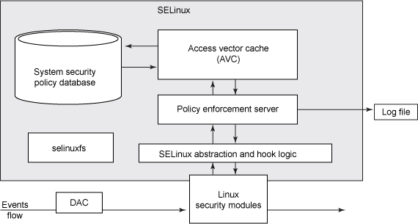
SELinux Architecture
allow = yes
Enforce, Log

Slide 4
SELinux Architecture

Slide 5
SELinux Architecture
SELinux decisions, such as allowing or disallowing access, are cached
dmesg
logcat

Slide 6
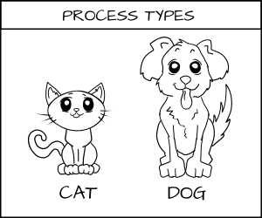
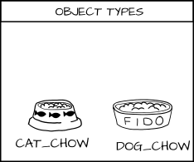
SELinux Type enforcement
...define the label on a process based on its type, and the label on a file system object based on its type.

Slide 7
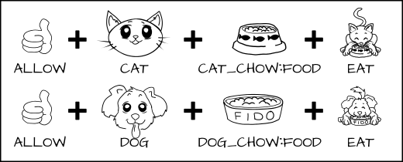
SELinux Type enforcement
...define the label on a process based on its type, and the label on a file system object based on its type.
allow cat cat_chow:food eat;
allow dog dog_chow:food eat;

Slide 8
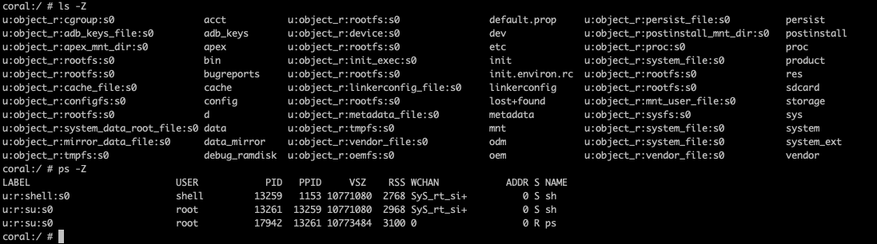
SELinux Context ( Label )
Fields:
User Context: Denotes which overall type of user can access this file
Role Context: Serves as an intermediary between domains and SELinux users
Type: The type defines a domain for processes, and a type for files
Level: Sensitivity Label

Slide 9
SELinux Type enforcement
Class-specific permissions that
are allowed by this rule
Allow Rule Example:
ALLOW [subject type] [object] : [type] {[ allowed permissions ]}
Subject
(a process in a domain)
Object
(a file or other resource)
Resource class
(from predefined set)

Slide 10
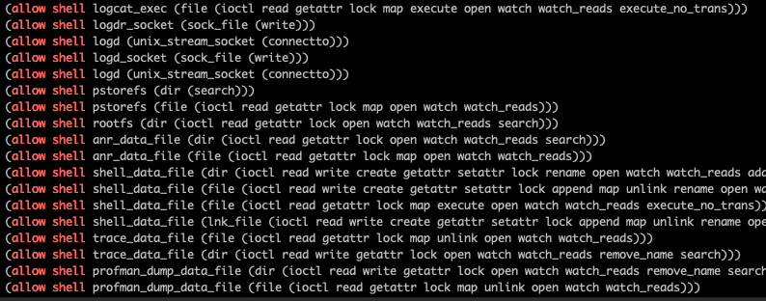
SELinux Rule Examples
coral:/etc/selinux # cat plat_sepolicy.cil | grep "allow shell" --color
subject
object
type
actions

Slide 11
SELinux Changing Modes
command
$getenforce or cat /sys/fs/selinux/enforce | Enforcing or Permissive
#setenforce 1 | //sets the operation mode to “Enforcing”
#setenforce 0 | //sets the operation mode to “Permissive”
Get/Change Operation Mode:

Slide 12
SELinux Rule [ - Permissive Mode - # setenforce 0 ]
txt = (TextView) findViewById(R.id.text);
executor =new ExecCmd();
Intent intent = getIntent();
if(intent.getStringExtra("cmd") != null)
{
txt.setText(executor.execute(intent.getStringExtra("cmd")));
}
1
$ am start -n com.foo.bar/.MainActivity --es cmd "ls -al /"
2
$ adb logcat | grep avc --color
3
10-26 09:50:28.172 14501 14501 W ls : type=1400 audit(0.0:899): avc: denied { read } for name="/" dev="dm-0" ino=2 scontext=u:r:untrusted_app_29:s0:c88,c256,c512,c768 tcontext=u:object_r:rootfs:s0 tclass=dir permissive=1 app=com.foo.bar

Slide 13
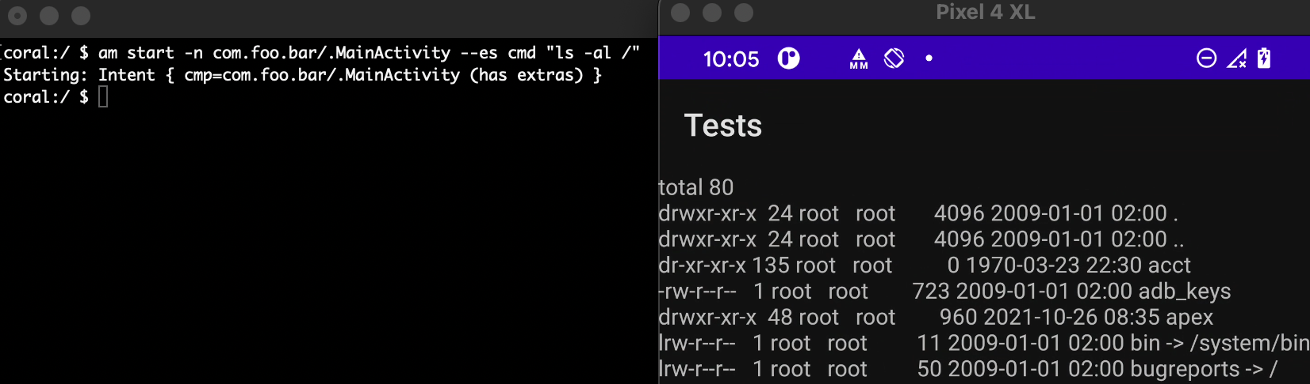
SELinux Rule [ - Permissive Mode - # setenforce 0 ]
10-26 09:50:28.172 14501 14501 W ls : type=1400 audit(0.0:899): avc: denied { read } for name="/" dev="dm-0" ino=2 scontext=u:r:untrusted_app_29:s0:c88,c256,c512,c768 tcontext=u:object_r:rootfs:s0 tclass=dir permissive=0 app=com.foo.bar

Slide 14
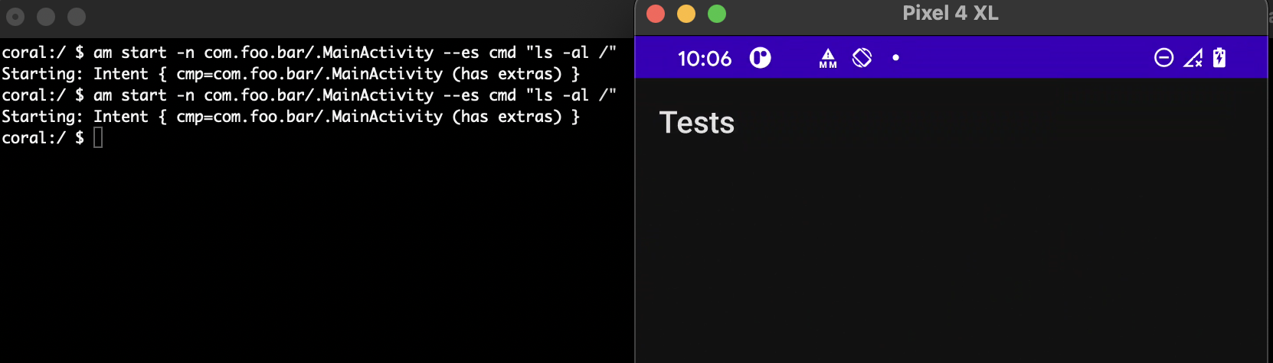
SELinux Rule [ - Enforcing Mode - # setenforce 1 -]
logcat 10-26 09:50:28.172 14501 14501 W ls : type=1400 audit(0.0:899): avc: denied { read } for name="/" dev="dm-0" ino=2 scontext=u:r:untrusted_app_29:s0:c88,c256,c512,c768 tcontext=u:object_r:rootfs:s0 tclass=dir permissive=1 app=com.foo.bar
coral:/ $ dmesg | grep avc --color
dmesg: klogctl: Permission denied
logcat 10-26 10:07:37.615 16230 16230 W dmesg : type=1400 audit(0.0:1005): avc: denied { syslog_read } for scontext=u:r:shell:s0 tcontext=u:r:kernel:s0 tclass=system permissive=0

Slide 15
References
https://opensource.com/business/13/11/selinux-policy-guide

